Slide 1

CARDIOFIT AI
R24-019

Slide 2

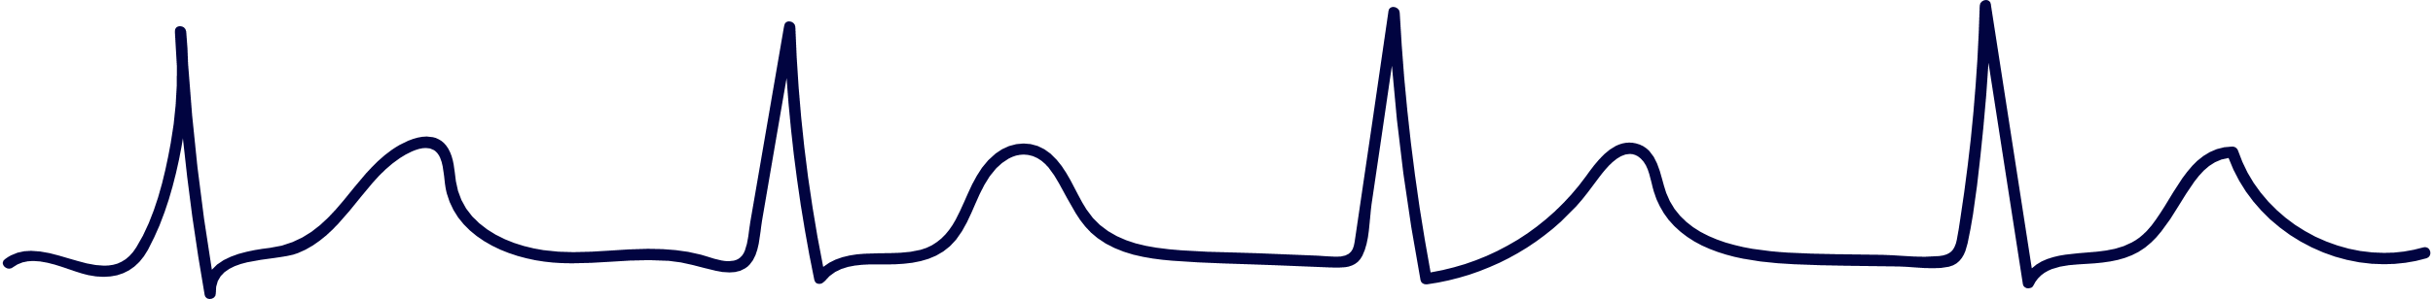
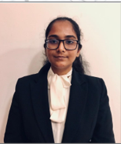

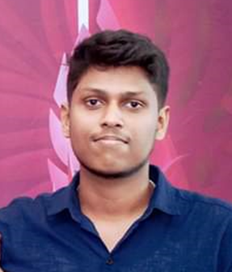
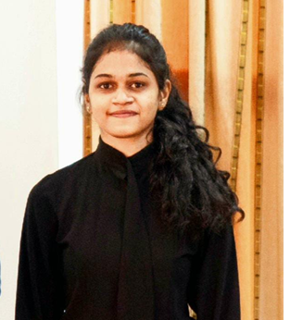

TEAM MEMBERS
Vihansa S.A.S
IT21134180
Senadheera P.V.P.P
IT21126888
Wijeratne D.M.S.D
IT21138386
Christy H.M
IT21127946
9/11/2024
2

Slide 3

INTRODUCTION
Even in an era where technology is at its pinnacle, Millions of human lives are still at risk
Over 17.9 million people die due to cardiovascular diseases annually.
Millions of people are struggling at hospitals due to cardiac arrhythmia.
Critical misdiagnosis of cardiac diseases results in deaths that could have been prevented.
Prominent reason for spread of non communication diseases is unhealthy dietary patterns.
9/11/2024
3

Slide 4

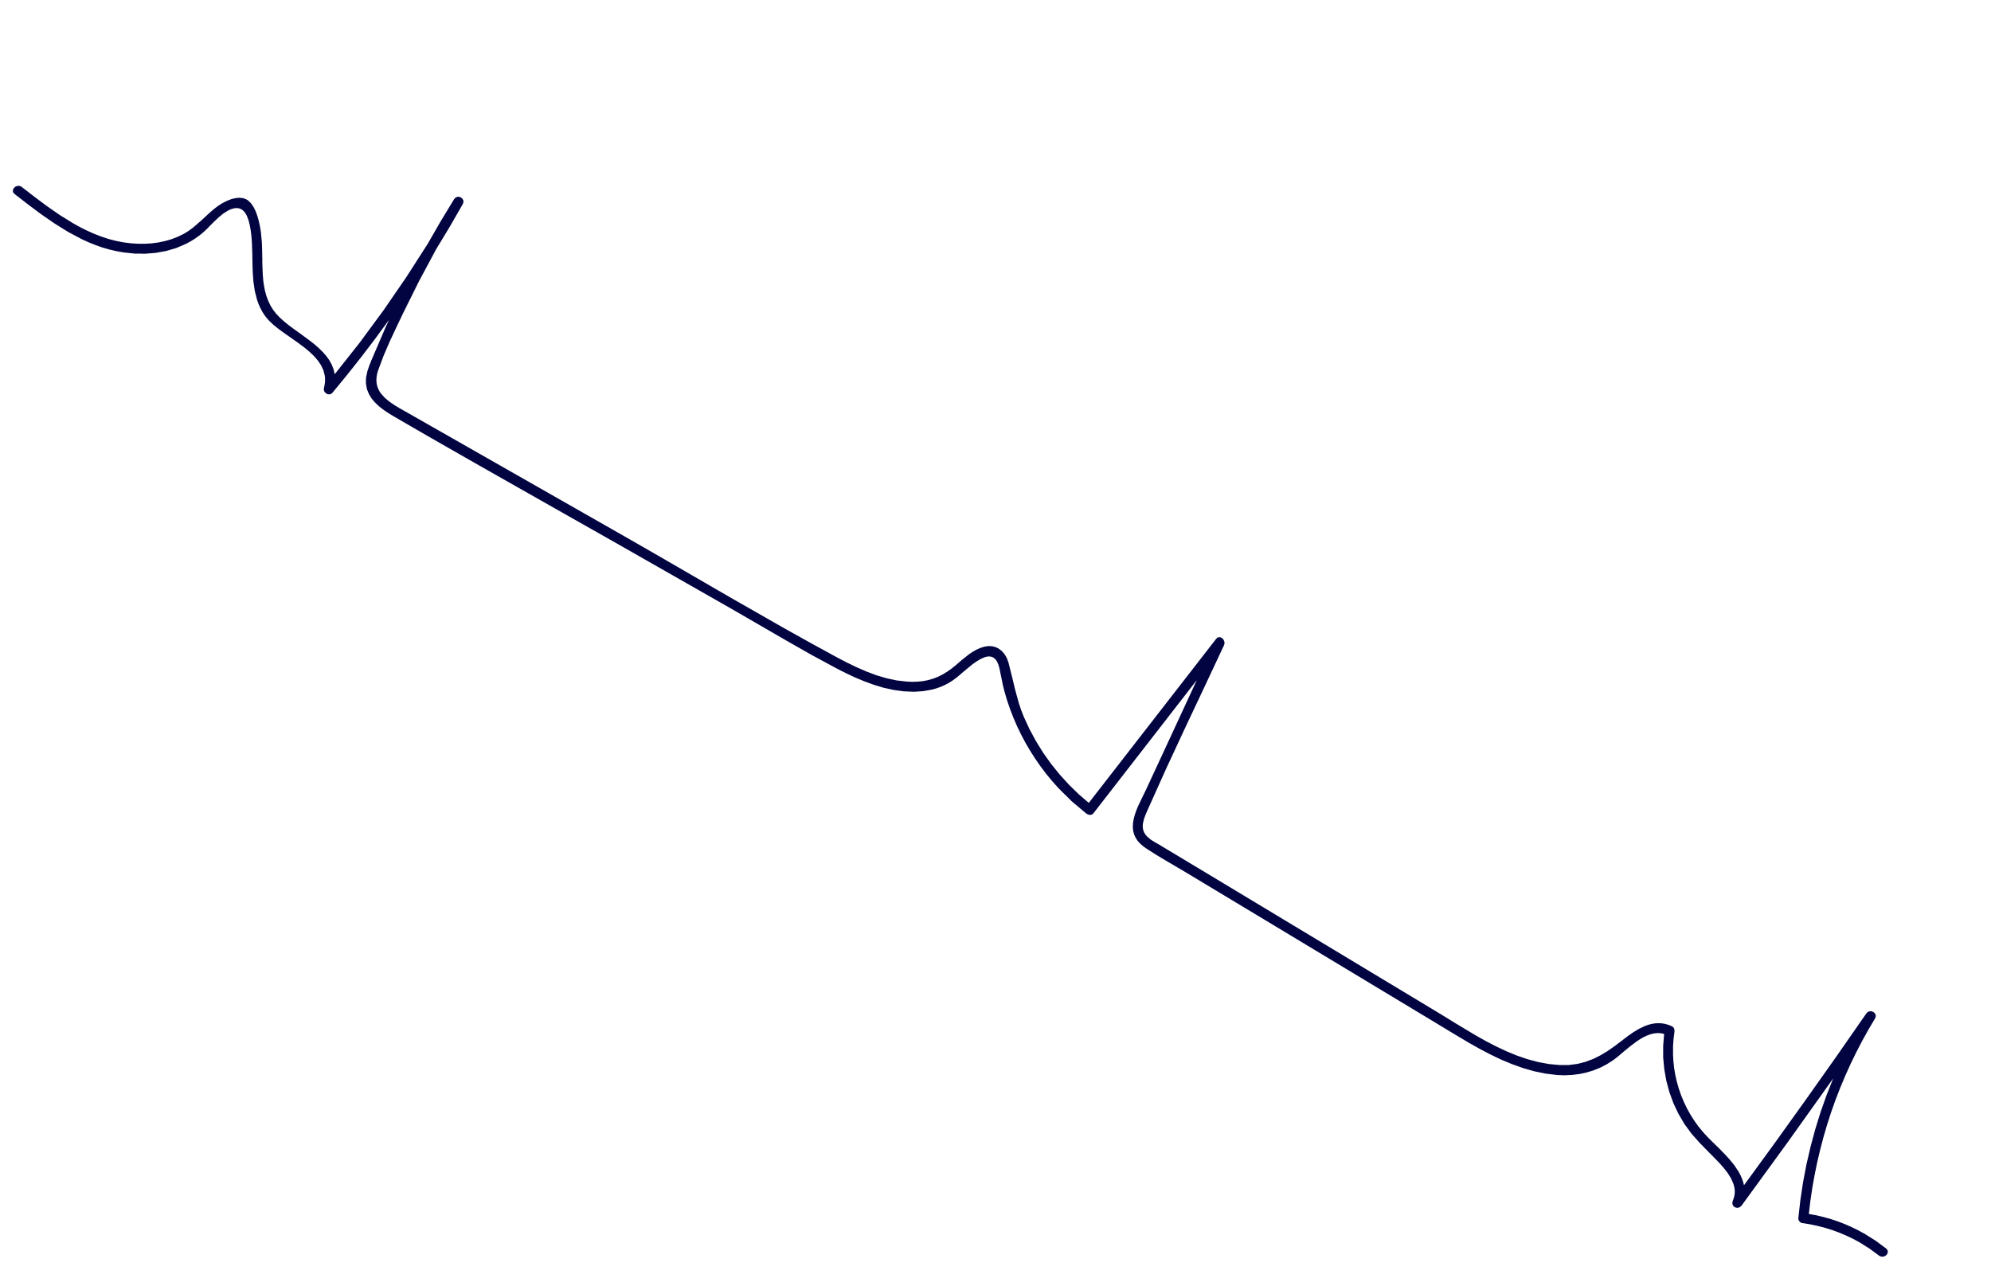

RESEARCH OBJECTIVES
Acquisition of ECG signal from palm-based approach.
Reconstructing remaining 11 ECG leads with high level of accuracy from lead I ECG signal.
Identification of critical cardiac diseases, allowing for informed discussion.
Proposing dietary advice based on patient health records.
9/11/2024
4

Slide 5
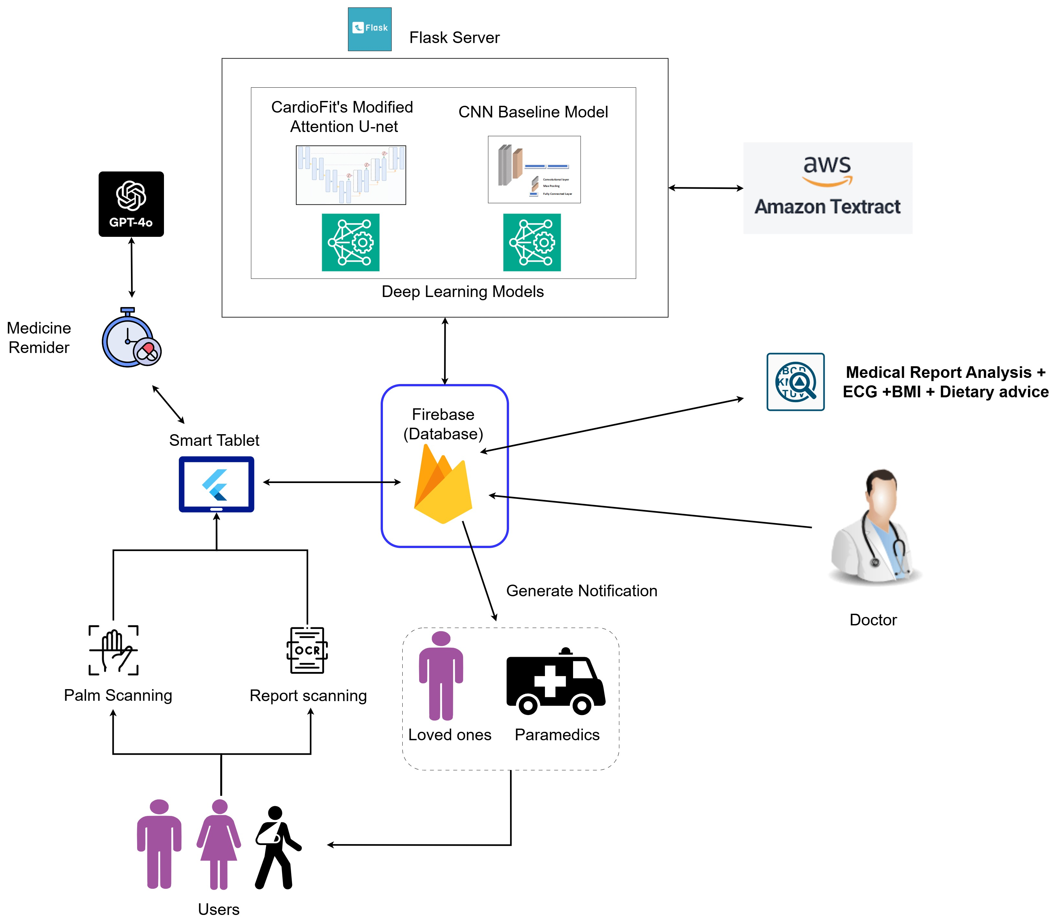
System Diagram
9/11/2024
5

Slide 6

IT21138386 | Wijeratne D.M.S.D
Specialization : Software Engineering
IT21138386 | Wijeratne D.M.S.D | R24-019

Slide 7
Research Questions &Objectives
RESEARCH QUESTION:
How can a Lead I ECG signal be accurately obtained from the palms using disposable gel electrodes?
SPECIFIC OBJECTIVE:
Development and validation of a system to collect Lead I ECG signals using disposable electrodes on the palms.
SUB OBJECTIVES:
Lead I ECG Signal acquisition from Palms.
Validation of obtained Lead I ECG signal.
9/11/2024
7
IT21138386 | Wijeratne D.M.S.D | R24-019

Slide 8
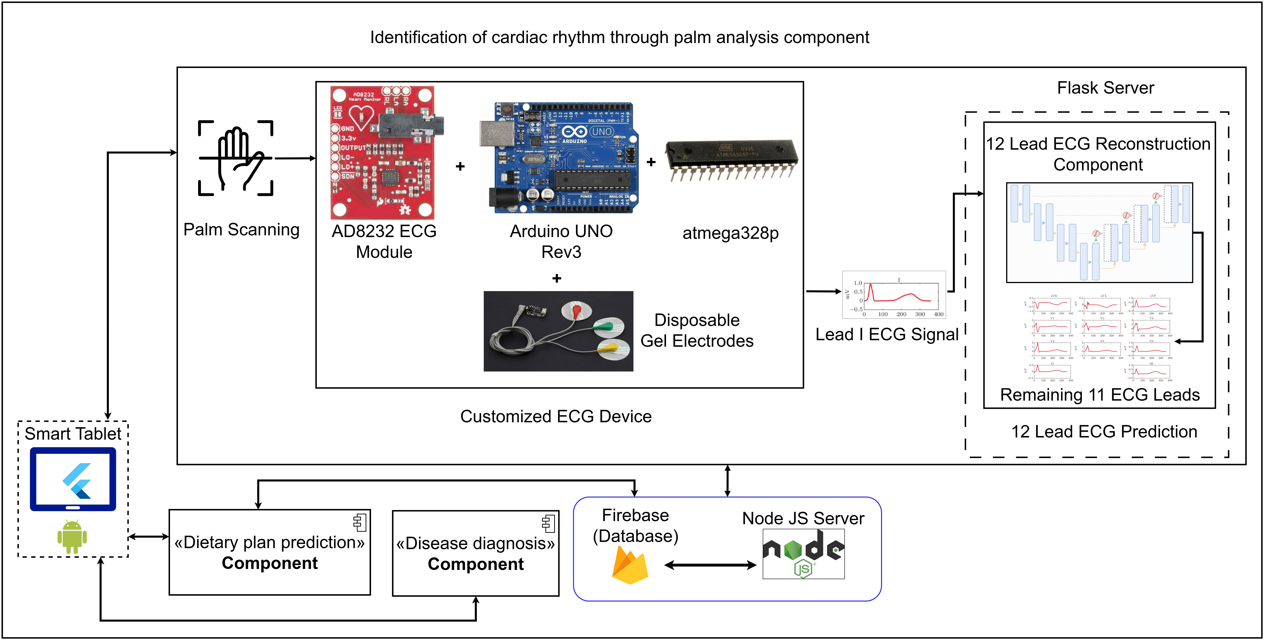
Methodology
9/11/2024
8
IT21138386 | Wijeratne D.M.S.D | R24-019

Slide 9
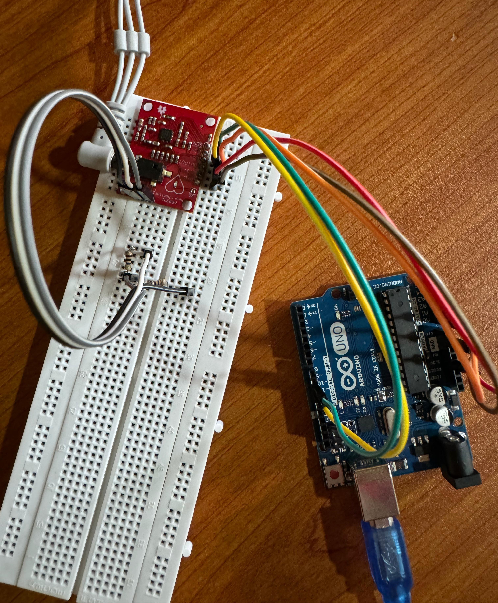
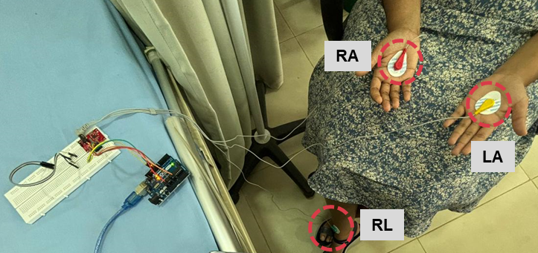
Evidence of Completion
SUB-OBJECTIVE 1 - LEAD I ECG SIGNAL ACQUISITION FROM PALMS
AD8232
(b) Electrode placement and setup
Arduino Uno Rev3 + atmega328p
(a) Proposed System consisting of AD8232 Module, Arduino UNO Rev 3 module and atmega328p microcontroller
9/11/2024
9
IT21138386 | Wijeratne D.M.S.D | R24-019

Slide 10
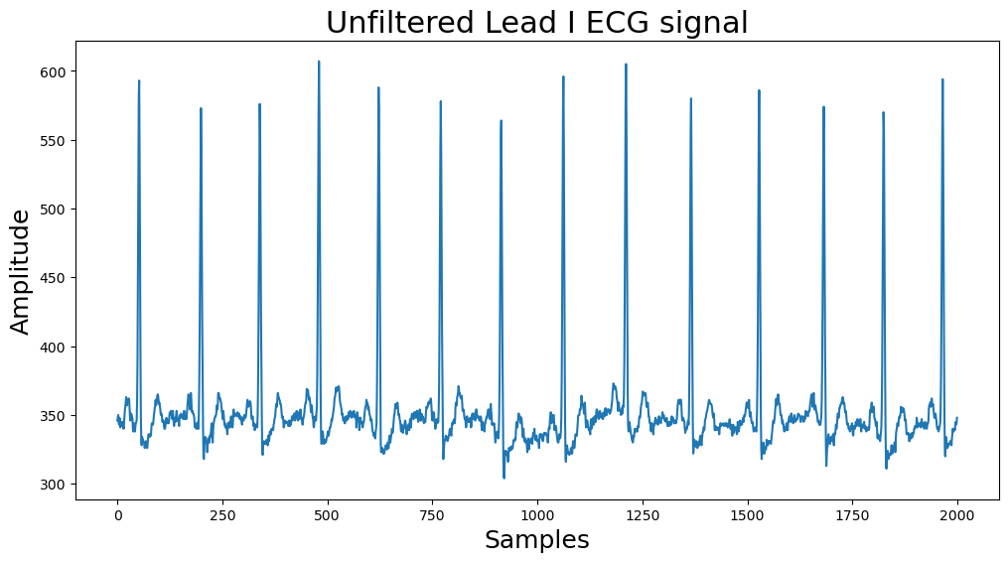
Evidence of Completion
SUB-OBJECTIVE 1 - LEAD I ECG SIGNAL ACQUISITION FROM PALMS
Successfully obtained a Lead I ECG signal from the palms using 3 disposable gel electrodes placed on both palms and the right leg.
(c) Raw Lead I ECG signal obtained
9/11/2024
10
IT21138386 | Wijeratne D.M.S.D | R24-019

Slide 11
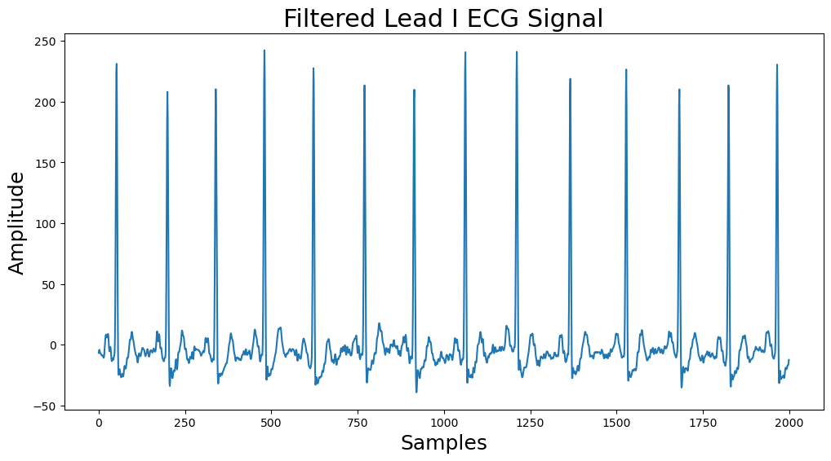
Evidence of Completion
SUB-OBJECTIVE 2 – VALIDATION OF OBTAINED LEAD I ECG SIGNAL
Addressed the impact of noise through filtering techniques.
(a) Unfiltered Lead I ECG signal
(b) Filtered Lead I ECG signal
9/11/2024
11
IT21138386 | Wijeratne D.M.S.D | R24-019

Slide 12
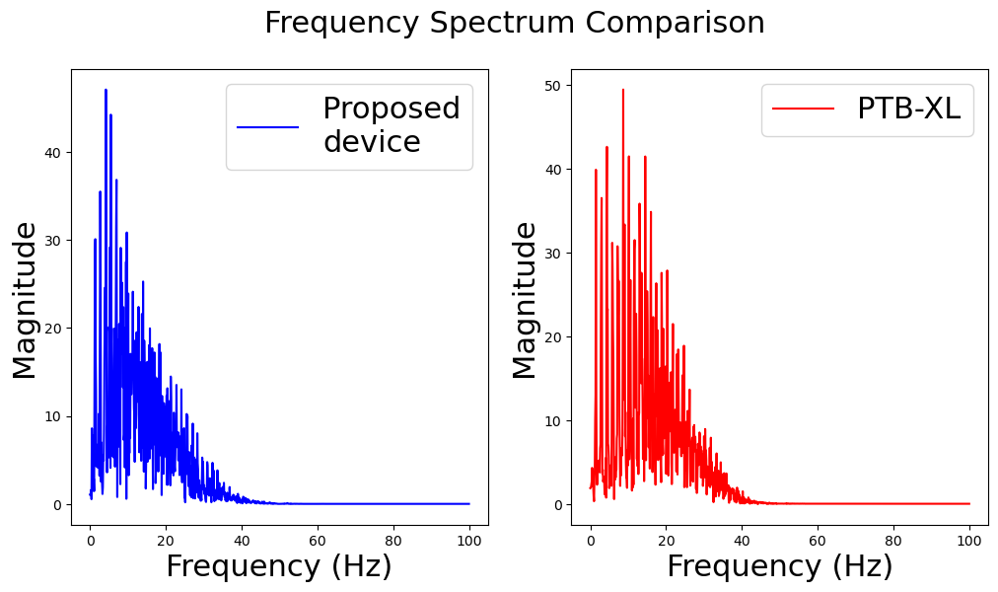
Evidence of Completion
SUB-OBJECTIVE 2 – VALIDATION OF OBTAINED LEAD I ECG SIGNAL
In ECG, frequency range typically lies between 0.5 Hz and 40 Hz
Low-frequency components (0.5 – 1 Hz) usually correspond to respiratory interference.
Mid-frequency components (1 – 20 Hz) represent the actual heartbeats (QRS complex and T-wave).
High-frequency components (>20 Hz) represent sharp transitions (spikes).
Main frequency components should lie between 0.5 Hz and 20 Hz
Frequencies outside 40 Hz, indicate noise due to motion artifacts, power line interference (usually at 50/60 Hz),
(c) Frequency spectrum comparison between Lead I obtained from proposed system against Lead I from PTB-XL Dataset
9/11/2024
12
IT21138386 | Wijeratne D.M.S.D | R24-019

Slide 13
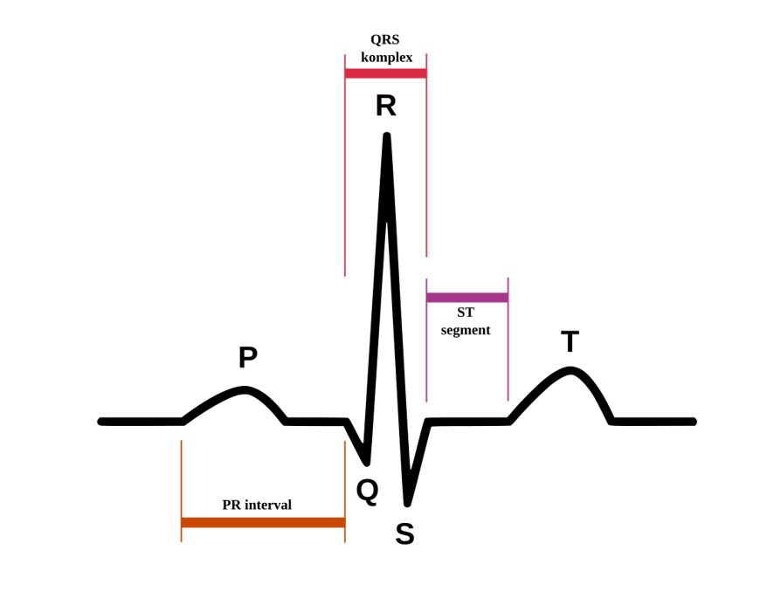
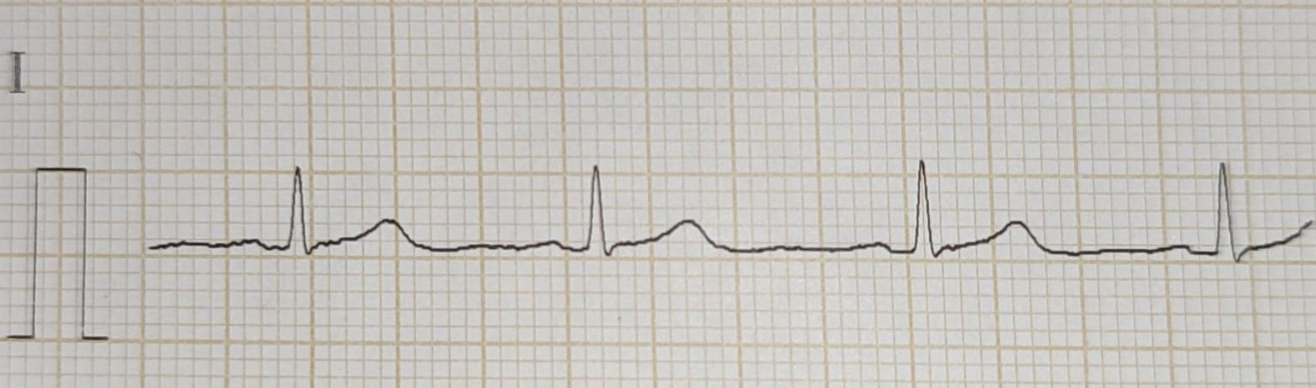
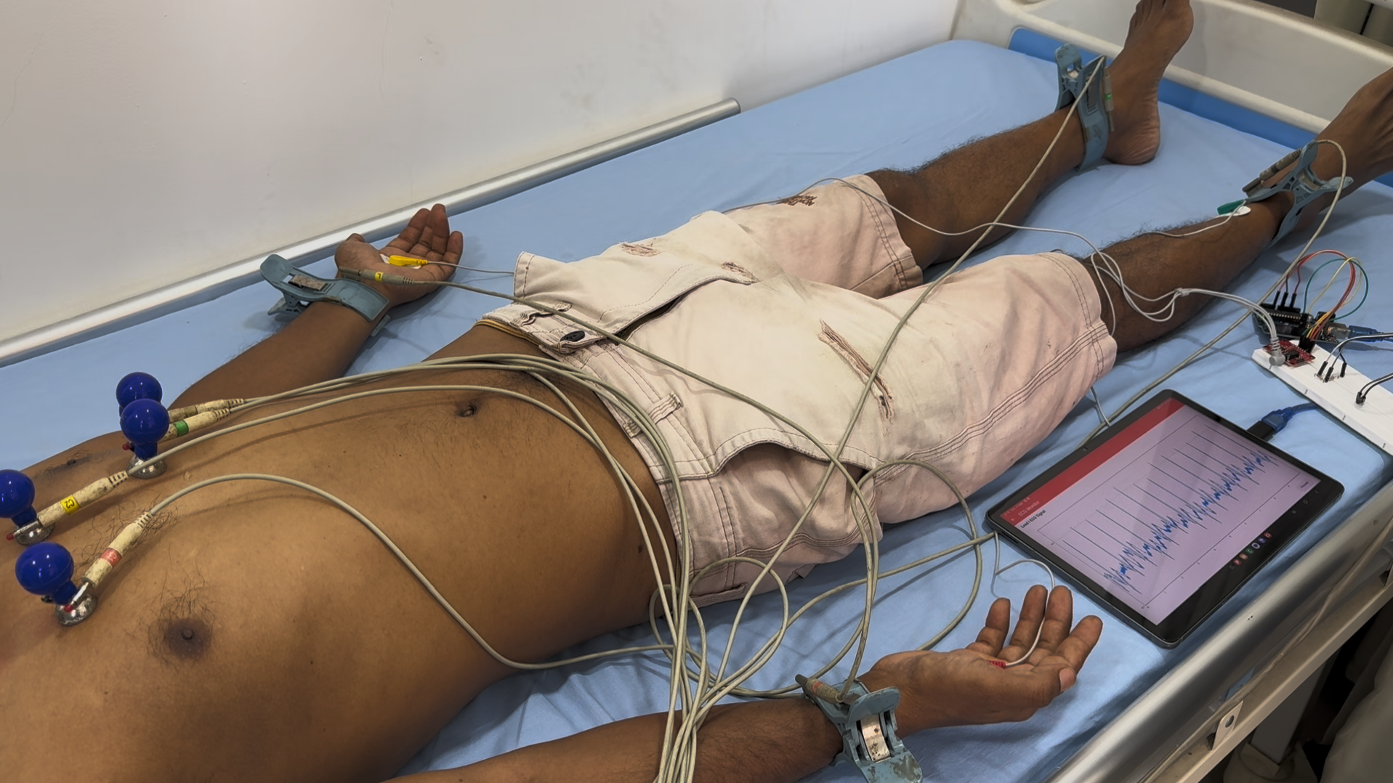
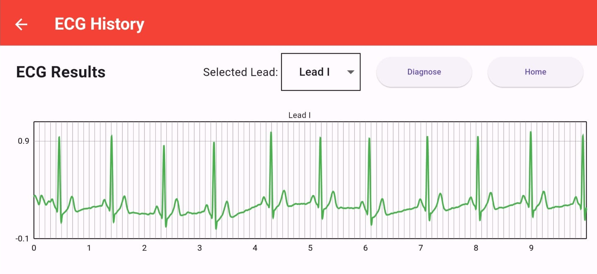
Evidence of Completion
SUB-OBJECTIVE 2 – VALIDATION OF OBTAINED LEAD I ECG SIGNAL
Conducted validation experiment comparing the obtained Lead I to a ground-truth Lead I ECG signal obtained from a traditional 12-Lead ECG machine.
ST Segment
QRS Complex
R
P
T
Q
S
PR Interval
QRS Complex
R
ST Segment
(d) Simultaneous ECG capturing with proposed system and traditional 12-Lead ECG device
P
Q
S
PR Interval
(f) Sample labeled ECG wave
(e) Comparison of obtained Lead I against ground truth
9/11/2024
13
IT21138386 | Wijeratne D.M.S.D | R24-019

Slide 14
Completed Sub-Objectives
SUB OBJECTIVES:
Lead I ECG Signal acquisition from Palms
Successfully implemented the setup using AD8232 module, Arduino UNO Rev 3 and atmega328p microcontroller.
Lead I ECG successfully extracted from the palms.
Validation of obtained Lead I ECG signal
The collected ECG signal has been validated for quality, ensuring it is ready for further use.
Successfully implemented noise filtering to improve signal quality.
9/11/2024
14
IT21138386 | Wijeratne D.M.S.D | R24-019

Slide 15
IT21126888 | Senadheera P.V.P.P
Specialization : Software Engineering
IT21126888 | Senadheera P.V.P.P | R24-019

Slide 16
Research Question & Objectives
Research Question
Specific Objective
How to extract 12-lead ECG data from a single ECG lead?
Reconstruction of 12-lead ECG from a single lead.
IT21126888 | Senadheera P.V.P.P | R24-019

Slide 17
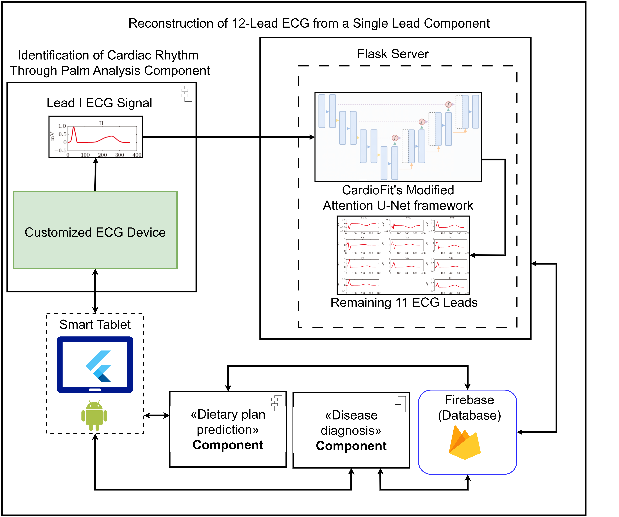
Methodology
IT21126888 | Senadheera P.V.P.P | R24-019

Slide 18
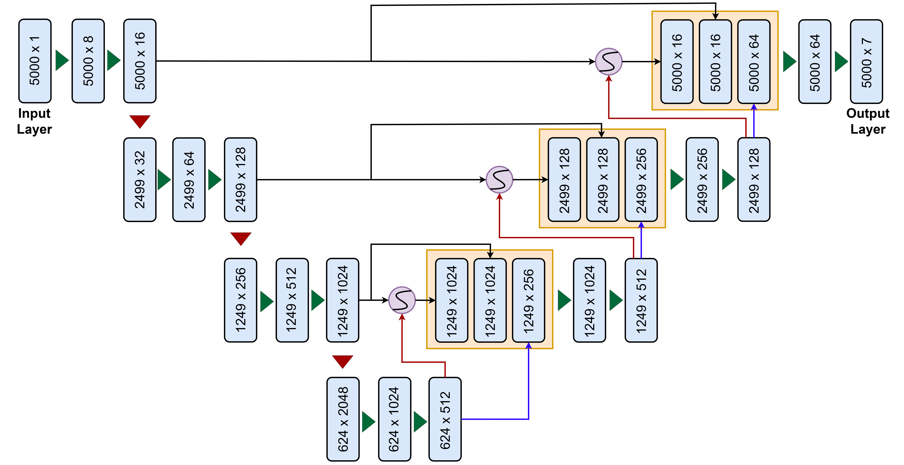
Progress Up to PP1
Model: 1
Input Signal: Lead II
Similarity (ρ): 77.52%
MSE: 0.0298
IT21126888 | Senadheera P.V.P.P | R24-019

Slide 19
Current Progress
Model: 2
Input Signal: Lead II
Similarity (ρ): 87.69%
MSE: 0.0158
IT21126888 | Senadheera P.V.P.P | R24-019

Slide 20
Current Progress Cont.
Model: 3
Input Signal: Lead II
Similarity (ρ): 86.51%
MSE: 0.0171
IT21126888 | Senadheera P.V.P.P | R24-019

Slide 21
Current Progress Cont.
Model: 4
Input Signal: Lead II
Similarity (ρ): 72.81%
MSE: 0.0333
IT21126888 | Senadheera P.V.P.P | R24-019

Slide 22
Current Progress Cont.
Model: 5
Input Signal: Lead I
Similarity (ρ): 88.31%
MSE: 0.0147
IT21126888 | Senadheera P.V.P.P | R24-019

Slide 23
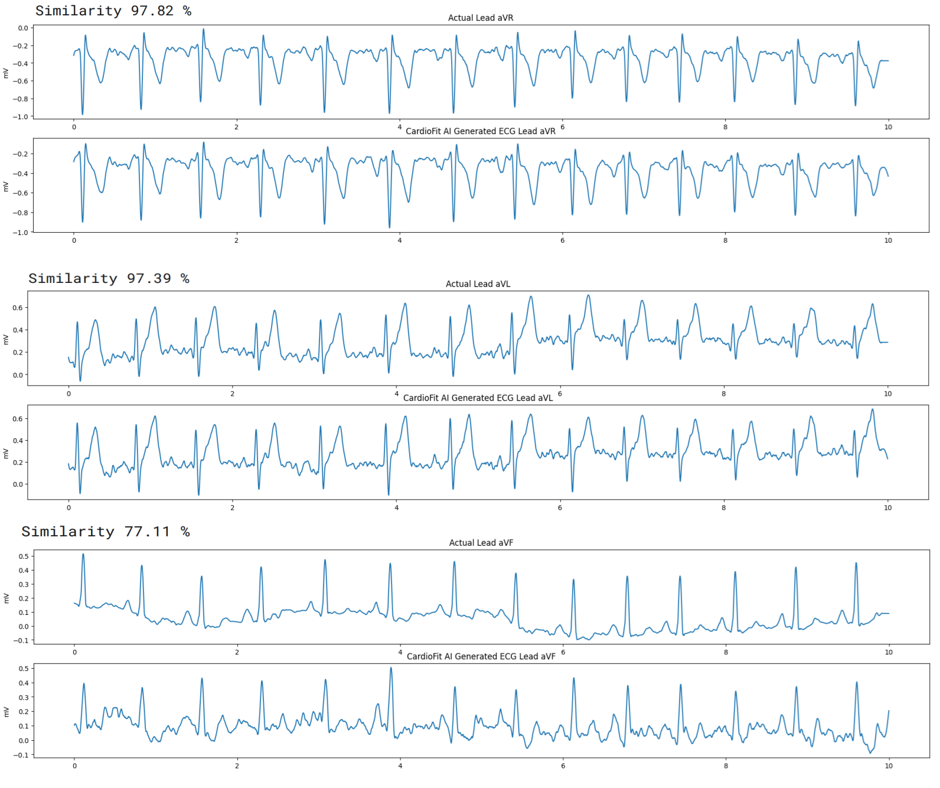
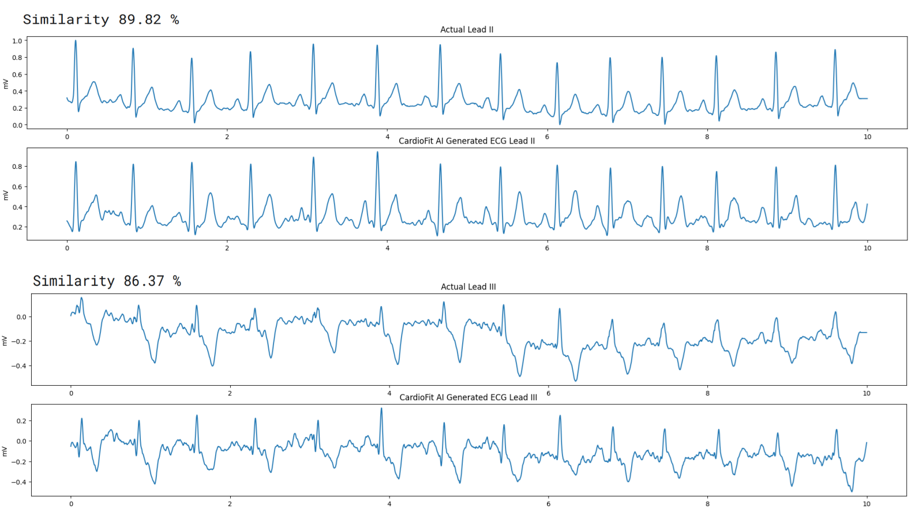
Evidence of Completion
IT21126888 | Senadheera P.V.P.P | R24-019

Slide 24
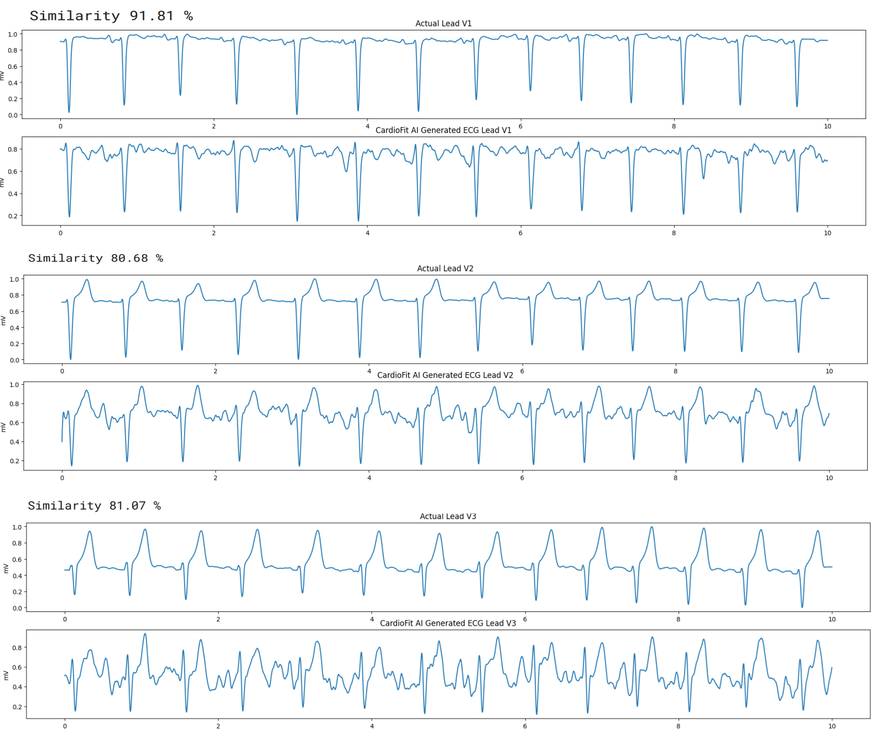
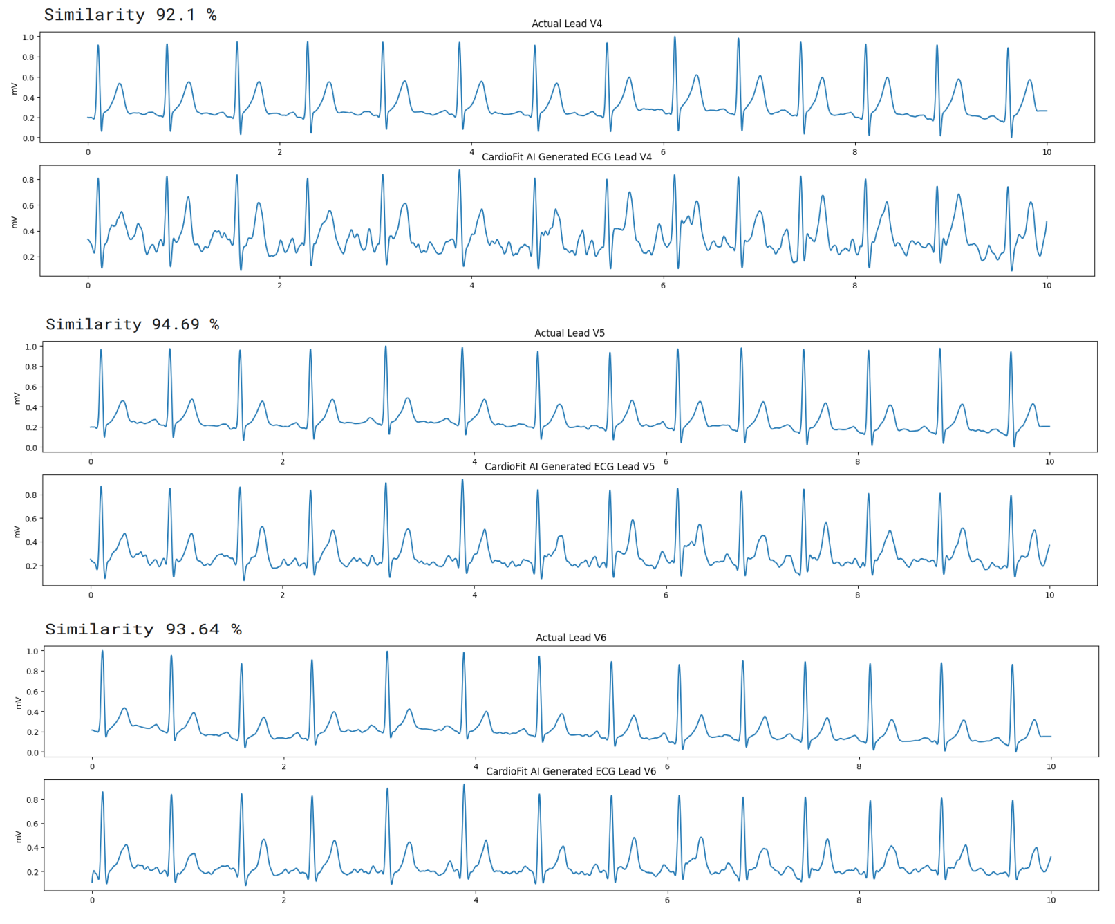
Evidence of Completion Cont.
IT21126888 | Senadheera P.V.P.P | R24-019

Slide 25
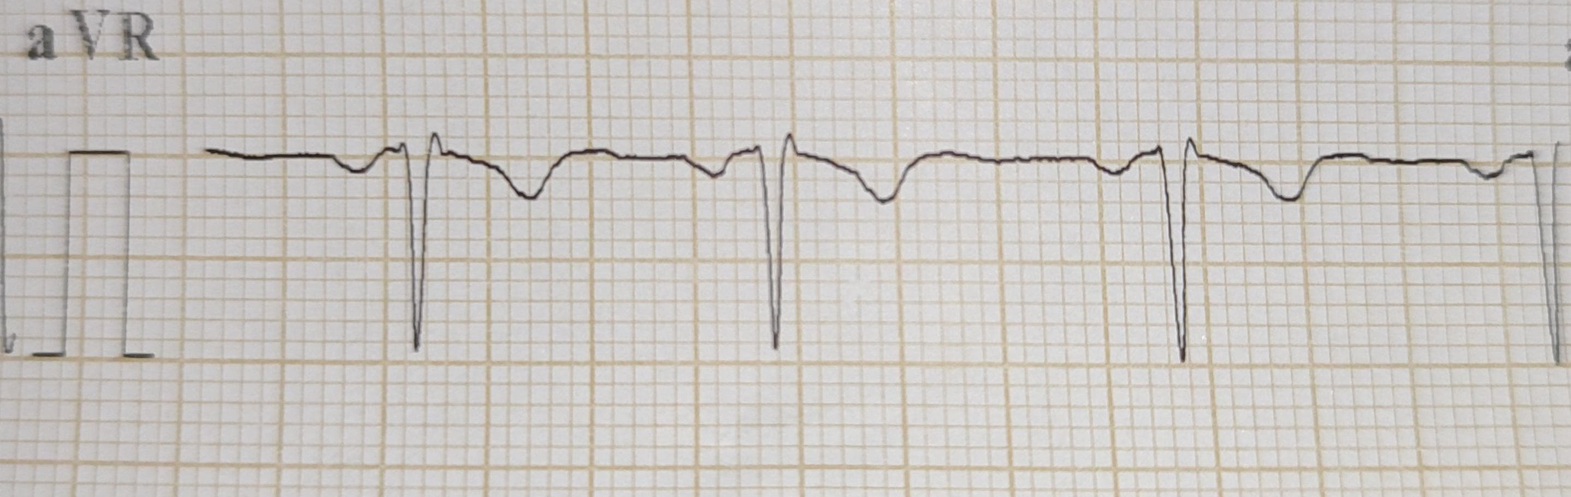
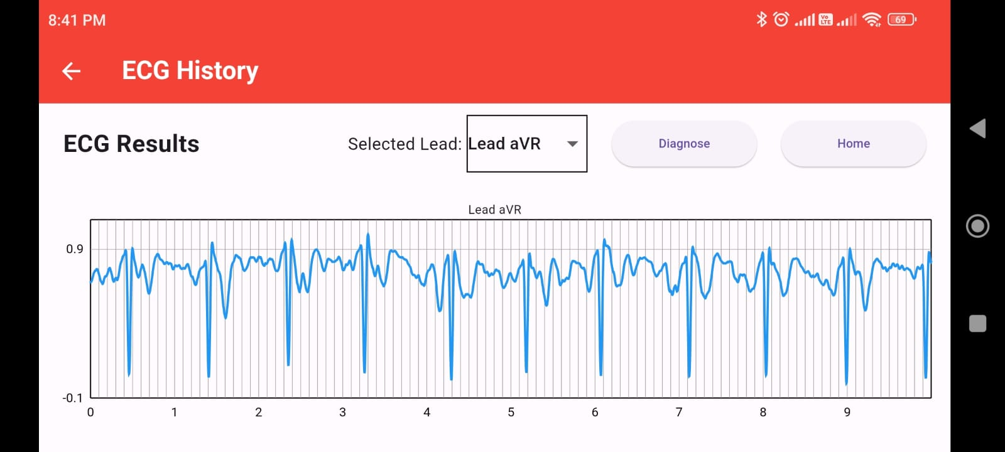
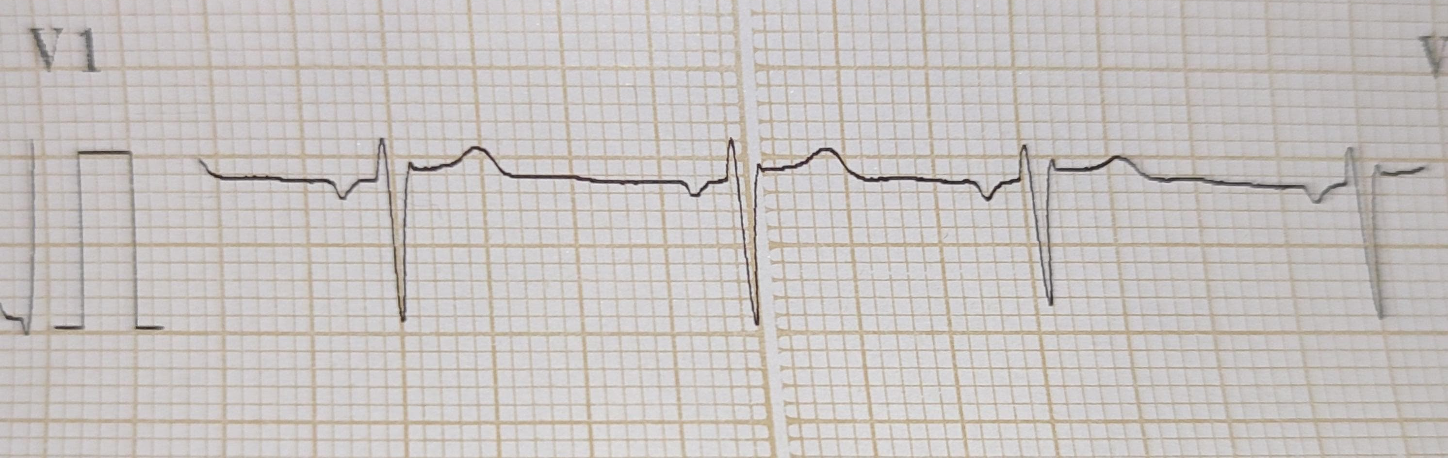
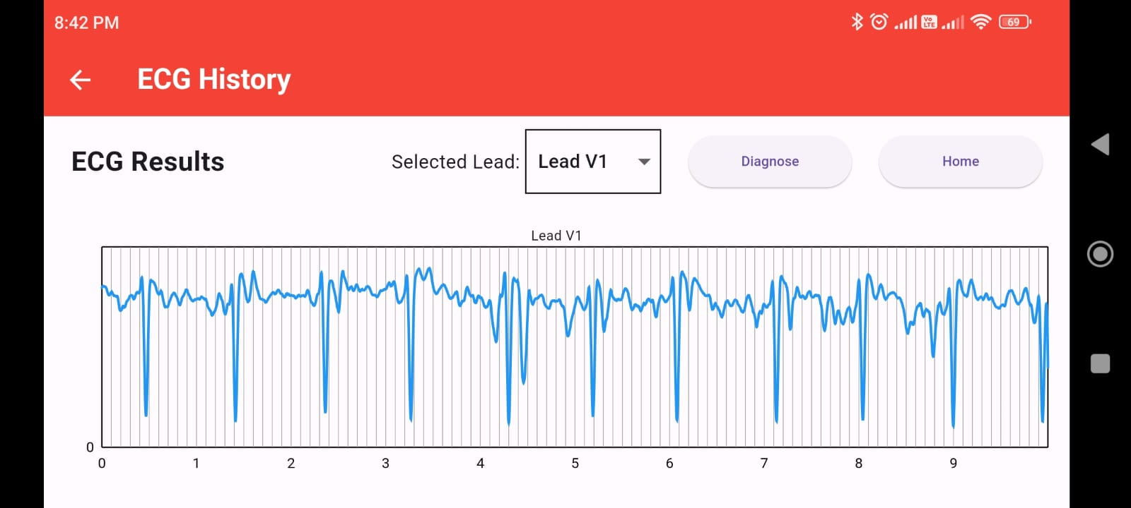
Evidence of Completion Cont.
IT21126888 | Senadheera P.V.P.P | R24-019

Slide 26
Completion of Sub-Objectives
Determine the optimal ECG lead for obtaining accurate readings suitable for extracting other leads.
Training the model to re-construct the remaining 11 ECG leads.
Design and implement a smart tablet-based platform for ECG viewing, facilitating user-friendly access and interpretation of cardiac data.
IT21126888 | Senadheera P.V.P.P | R24-019

Slide 27
IT21127946| Christy H.M
Specialization : Software Engineering

Slide 28
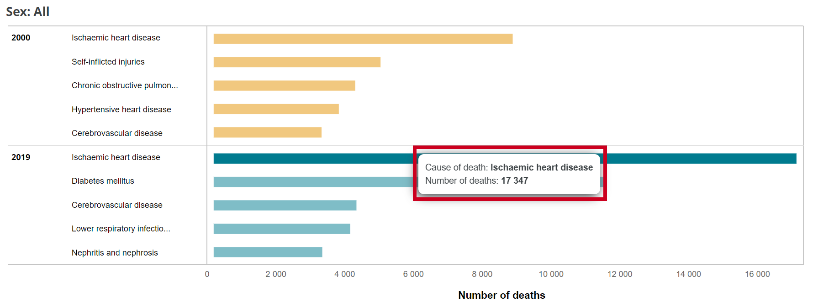
Background
Count = 17,347
Source - https://platform.who.int/mortality/countries/country-details/MDB/sri-lanka
IT21127946 | Christy H.M | R24-019

Slide 29
Research Problem
Ø How to avoid potential loss of lives via the prevention of the misdiagnosis of cardiac diseases, while providing timely notifications to loved ones in case of critical diagnoses, ensuring swift action is taken for optimal care and emergency response.
IT21127946 | Christy H.M | R24-019

Slide 30
Specific Objective
Ø Accurate cardiac diseases diagnosis via 12 lead ECG derived from palms, and providing timely notifications to loved ones in case of emergency.

Slide 31
Sub Objectives
^{Step 1}
^{Step 2}
^{Step 3}
^{Step 6}
^{Preprocess dataset.}
Train a model and classify diseases.
^{Display extracted ECG features}
^{Step 4}
^{Display diagnosis results}
^{Step 5}
Inform loved ones regarding patient's status.
Test the application with wide combination of data inputs.
IT21127946 | Christy H.M | R24-019

Slide 32
Identified Cardiac Arrhythmias
Myocardial Infarction
Cardial Conduction Disorders
Ischemic Heart Disease
01
02
03
IT21127946 | Christy H.M | R24-019

Slide 33
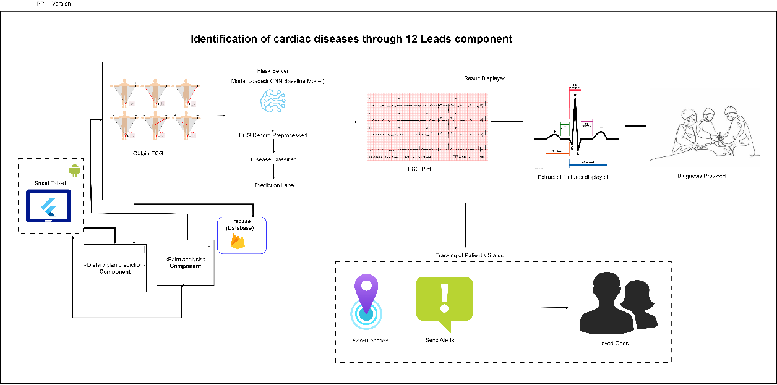
Methodology

Slide 34
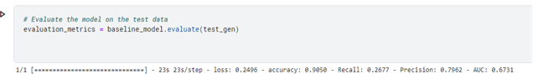
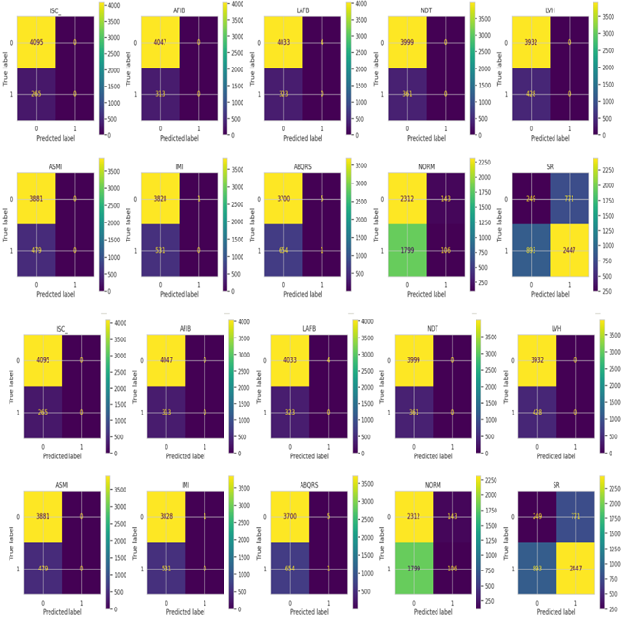
Model Results

Slide 35
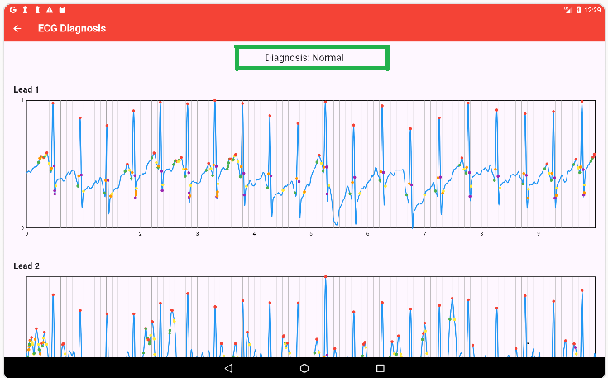
Evidence of Completion
DIAGNOSIS PREDICTED VIA THE 12 LEADS OBTAINED FROM PALMS
IT21127946 | Christy H.M | R24-019

Slide 36
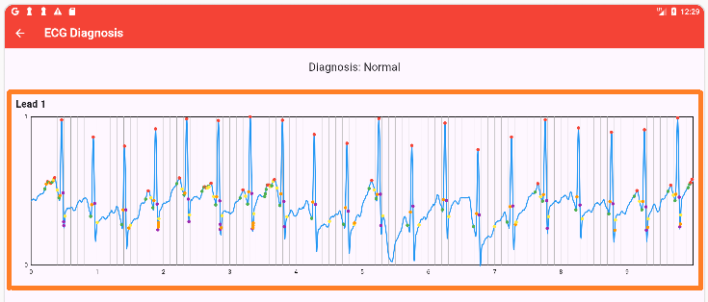
Evidence of Completion Cont.
ECG – LEAD I EXTRACTED AND DISPLAYED
IT21127946 | Christy H.M | R24-019

Slide 37
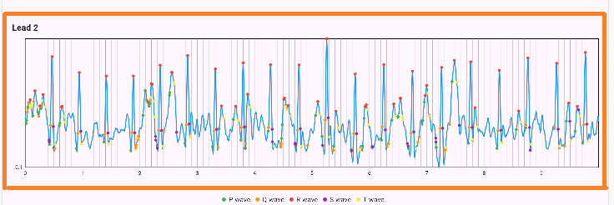
Evidence of Completion Cont.
ECG – LEAD II EXTRACTED AND DISPLAYED
IT21127946 | Christy H.M | R24-019

Slide 38
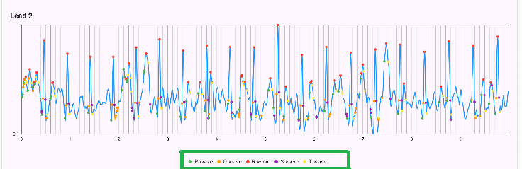
Evidence of Completion Cont.
ECG FEATURES EXTRACTION
IT21127946 | Christy H.M | R24-019

Slide 39
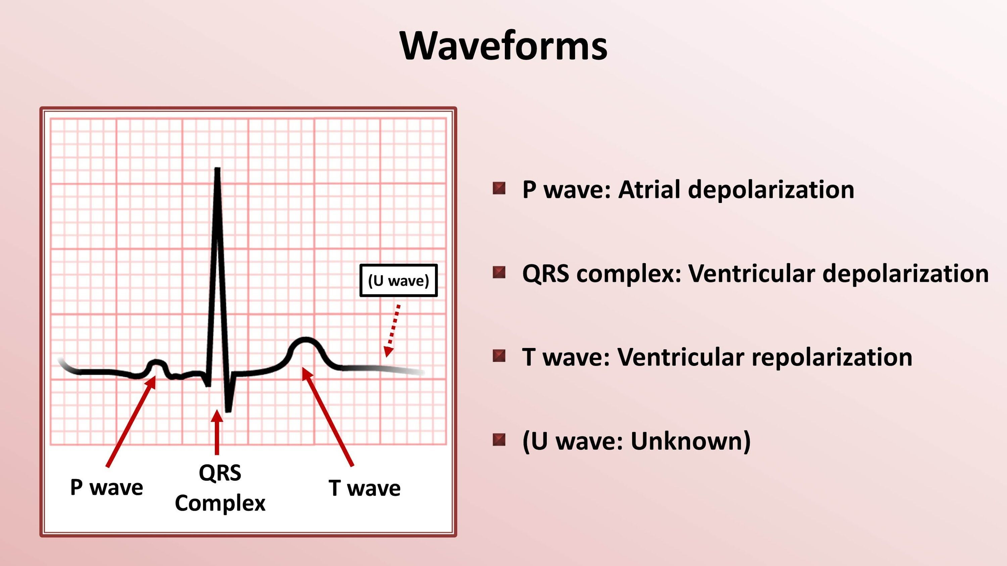
ECG Features Extracted
P wave - Represents atrial depolarization
(contraction of the atria).
QRS Complex - Indicates ventricular depolarization (contraction of the ventricles).
S wave - Part of the QRS complex, represents the final phase of ventricular depolarization.
T wave - Represents ventricular repolarization (relaxation of the ventricles).
ST segment - Indicates the period between ventricular depolarization and repolarization; it should be flat.
IT21127946 | Christy H.M | R24-019

Slide 40
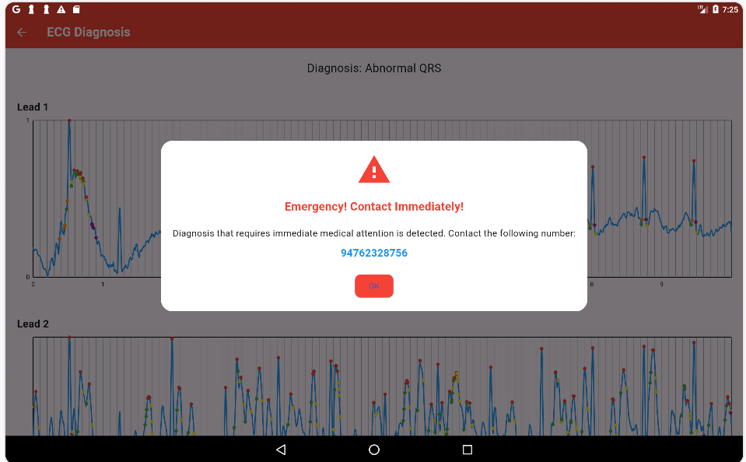
Evidence of Completion Cont.
EMERGENCY
CONTACT
IT21127946 | Christy H.M | R24-019

Slide 41

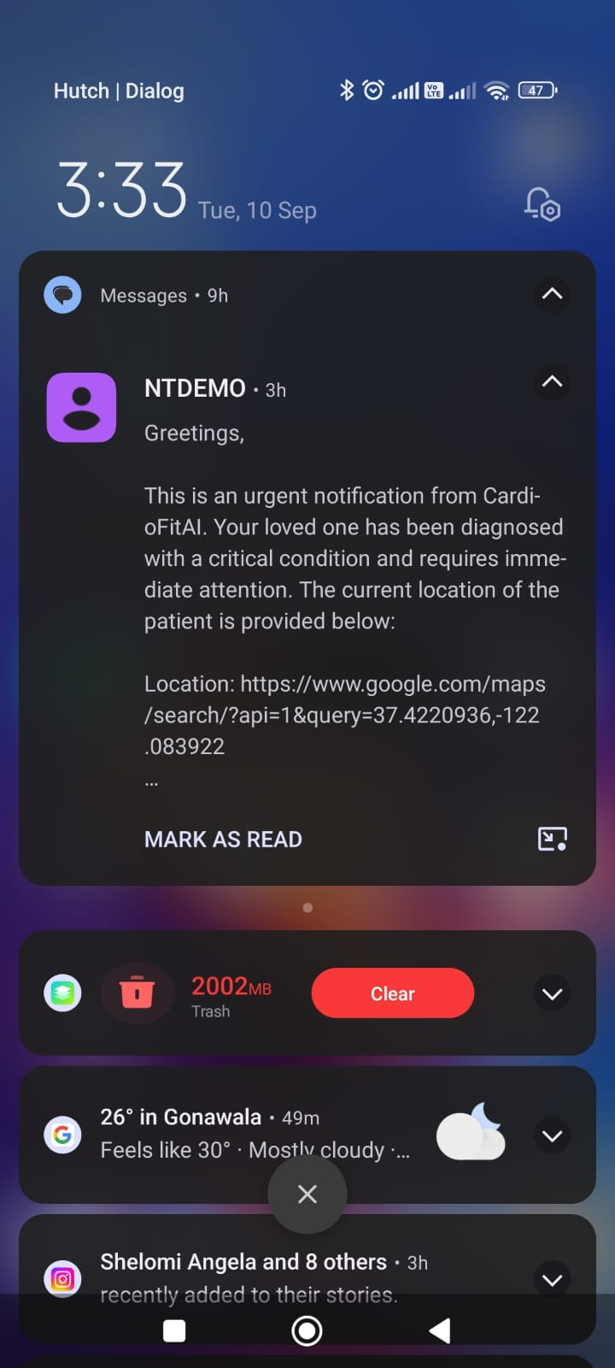
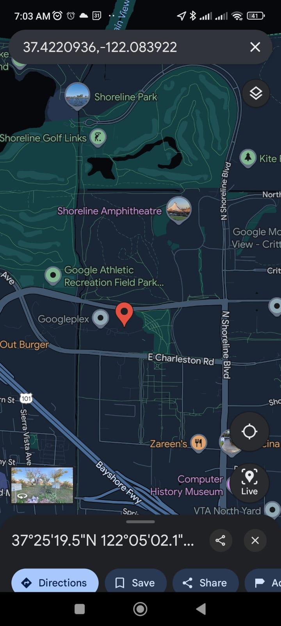
Evidence of Completion Cont.
MESSAGE NOTIFICATION ALONG WITH LIVE LOCATION OF PATIENT IS SHARED WITH THE LOVED ONES.
IT21127946 | Christy H.M | R24-019

Slide 42
Completion of the Project
Acquire and preprocess 12 lead ECG for better precision of results.
ECG features extracted. (P wave, QRS Complex, ST segment, Q wave, T wave)
Train a model for the purpose of identifying diseases.
Develop the mobile application in which the predicted disease is displayed.
Send live notifications to loved ones, incase of medical emergency.
Tested against a variety of inputs.
IT21127946 | Christy H.M | R24-019

Slide 43
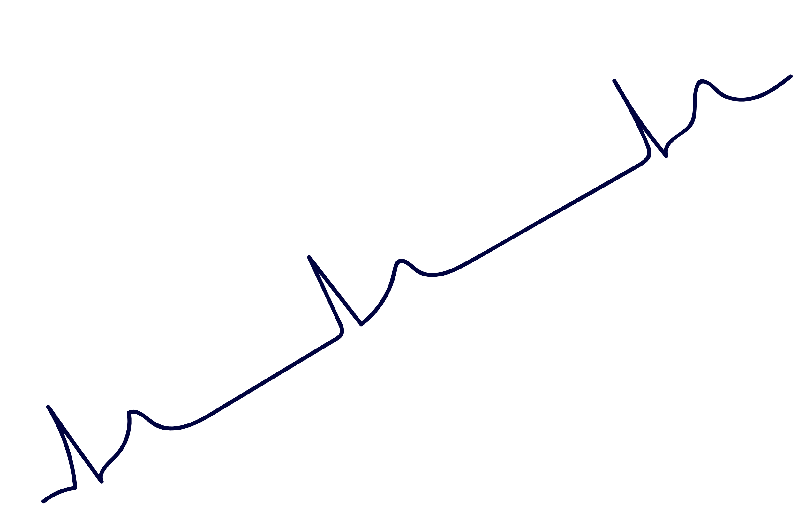
IT21134180 | VIHANSA S.A.S​
Specialization : Software Engineering

Slide 44

RESEARCH OBJECTIVES
Propose a customized dietary advice based on users ECG, medical report results and BMI​
01
Identify the analysis made by doctors observing patient health reports.
02
Collect necessary information to propose dietary advice in a customized manner.
03
Implement a proper methodology to scan and extract relevant components from users' medical reports and display its analysis
04
Based on the inputs obtained from user medical reports, BMI and Cardiac Health propose customize dietary advice

Slide 45
Research Problem
How to provide a customized dietary advice?
How to obtain the user demographic information to provide dietary advice?

Slide 46





Methodology
Trigger API
Call Adapter
Upload
Respond
Respond
Result
Flask Server
Medicine Report

Slide 47
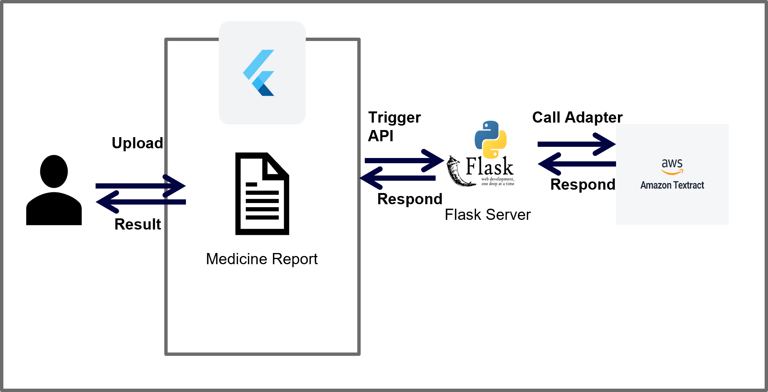
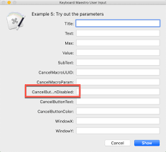


Methodology
User Profile
Blood Sugar + Blood cholesterol levels
Age , Gender, Height and Weight
ECG Component
Dietary Advice

Slide 48


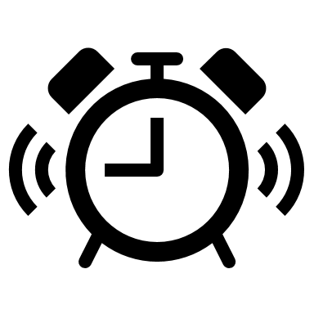

Methodology
Trigger
Upload
Medicine Prescription
Reminder
Respond

Slide 49
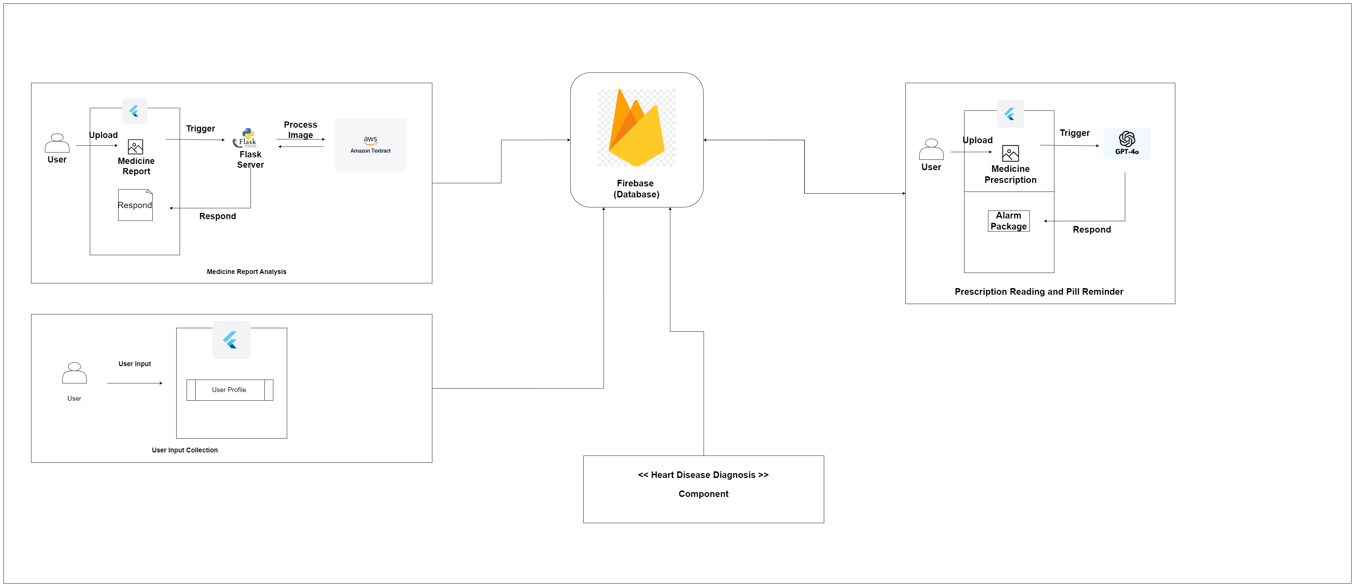
Methodology

Slide 50
Technologies and Tools Used
Technology | Purpose | Explanation | Why Selected?
Figma | Wireframe Design | Used for designing the interface and user experience | Easy collaboration and quick prototyping, widely adopted in UI/UX design
Flask Server | Medical Report Analysis | Acts as an intermediary service that communicates with AWS Textract | Lightweight, flexible, and well-suited for handling HTTP requests and APIs
AWS Textract | Medicine Report Analysis | Extracts text and data from scanned medical reports | Highly accurate OCR service integrated with other AWS tools for scalability
GPT 4o | Medical Report Analysis | Analyzes handwritten prescription information | Provides superior language understanding, can handle complex medical terminology
GitHub | Version Control | For tracking changes and collaboration in the project | Popular among developers, seamless integration with CI/CD pipelines
Flutter | Mobile Application Development | Framework used for developing the cross-platform mobile application | Single codebase for Android and iOS, great community support, fast development
Firebase | Database | Stores ECG and other medical data securely and efficiently | Real-time database with built-in security features, easy integration with mobile apps

Slide 51
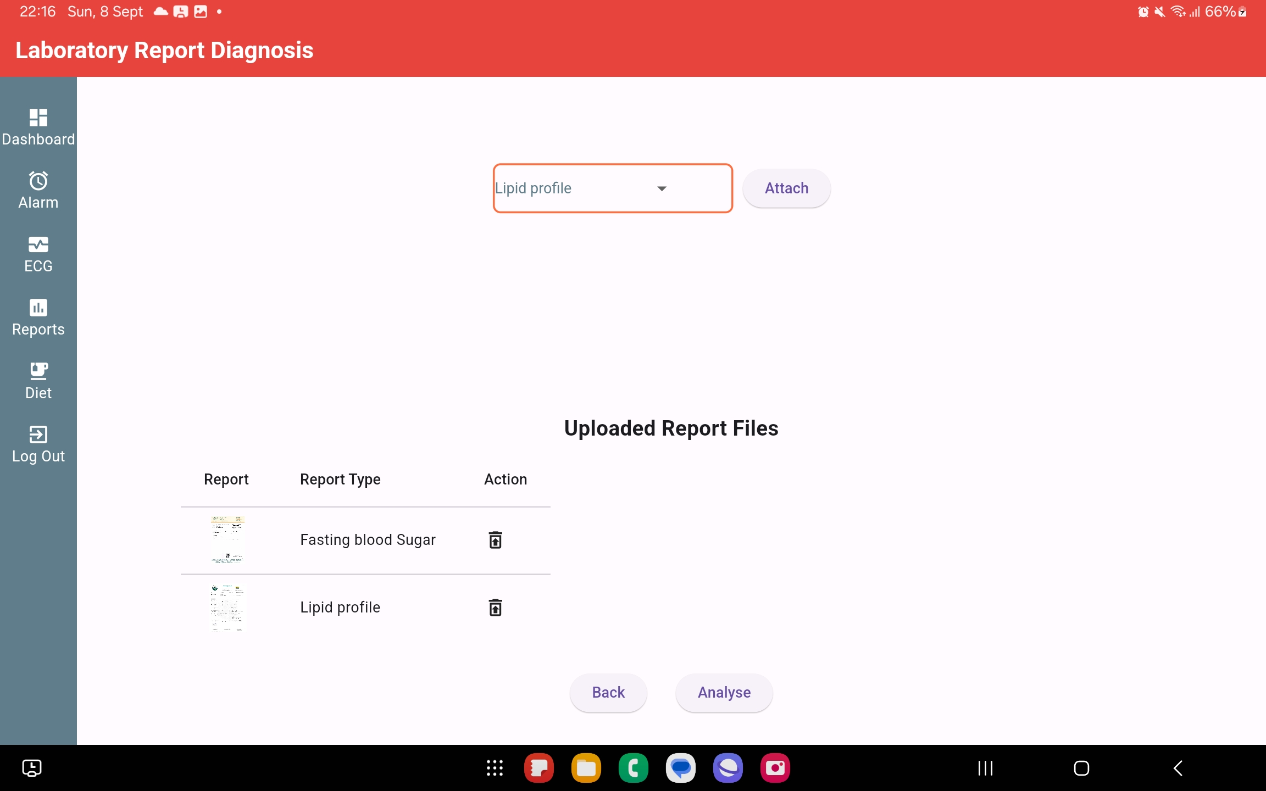
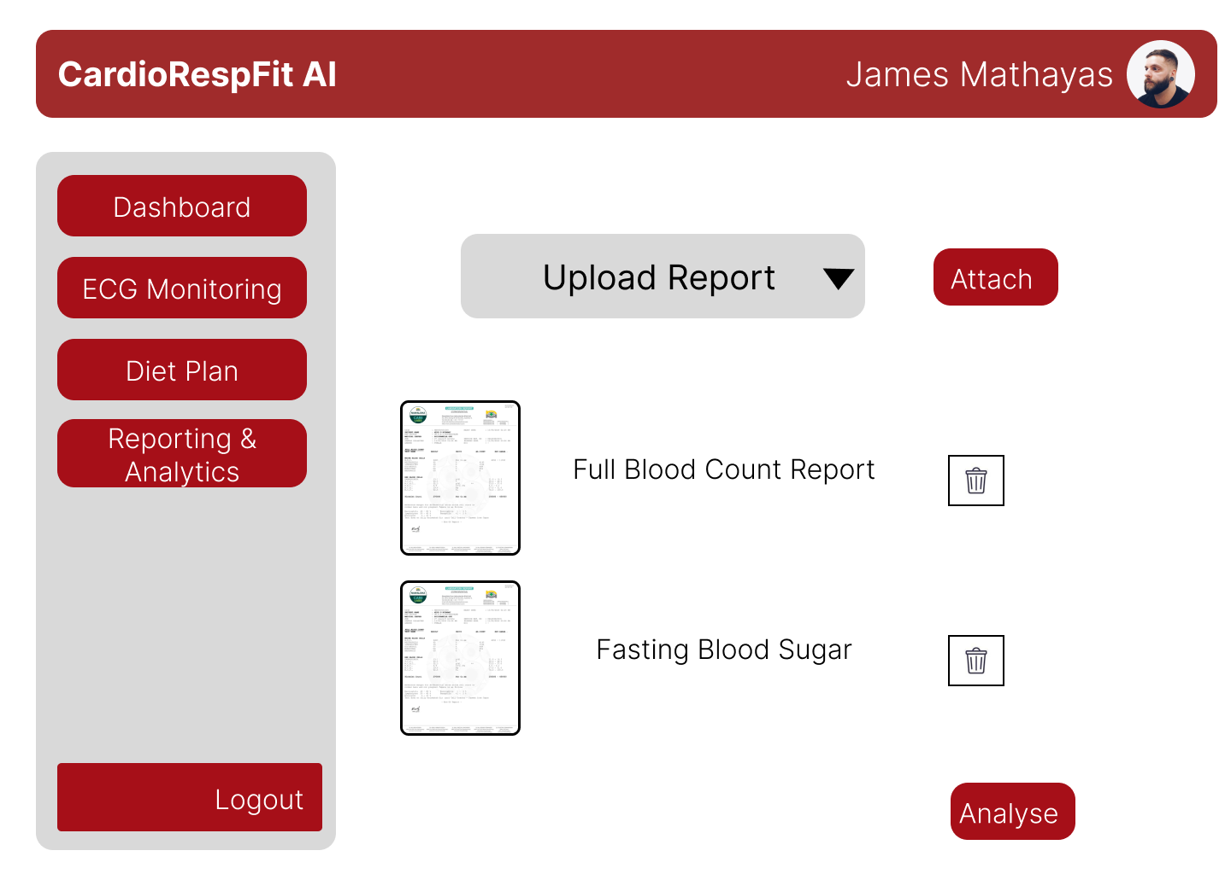
Proposed Vs Developed
Medicine Report Analysis Screen

Slide 52
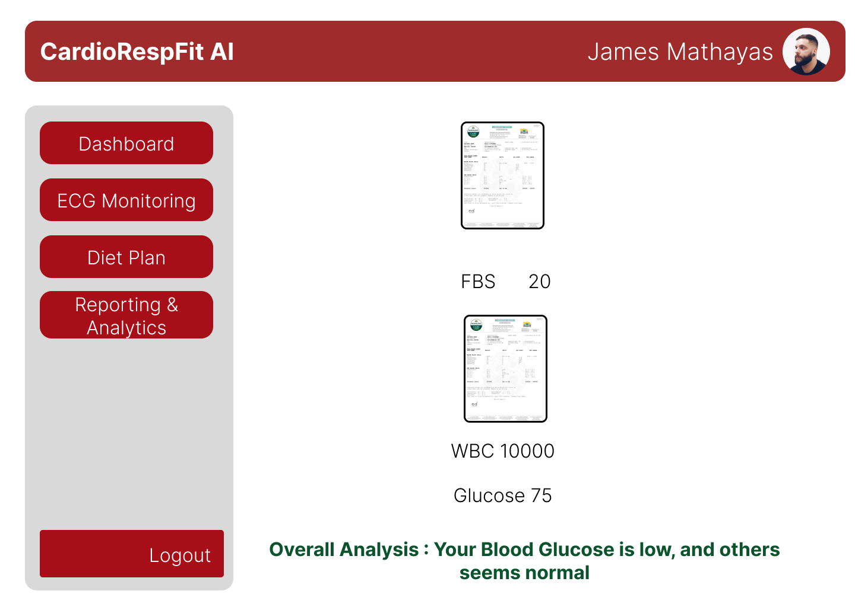
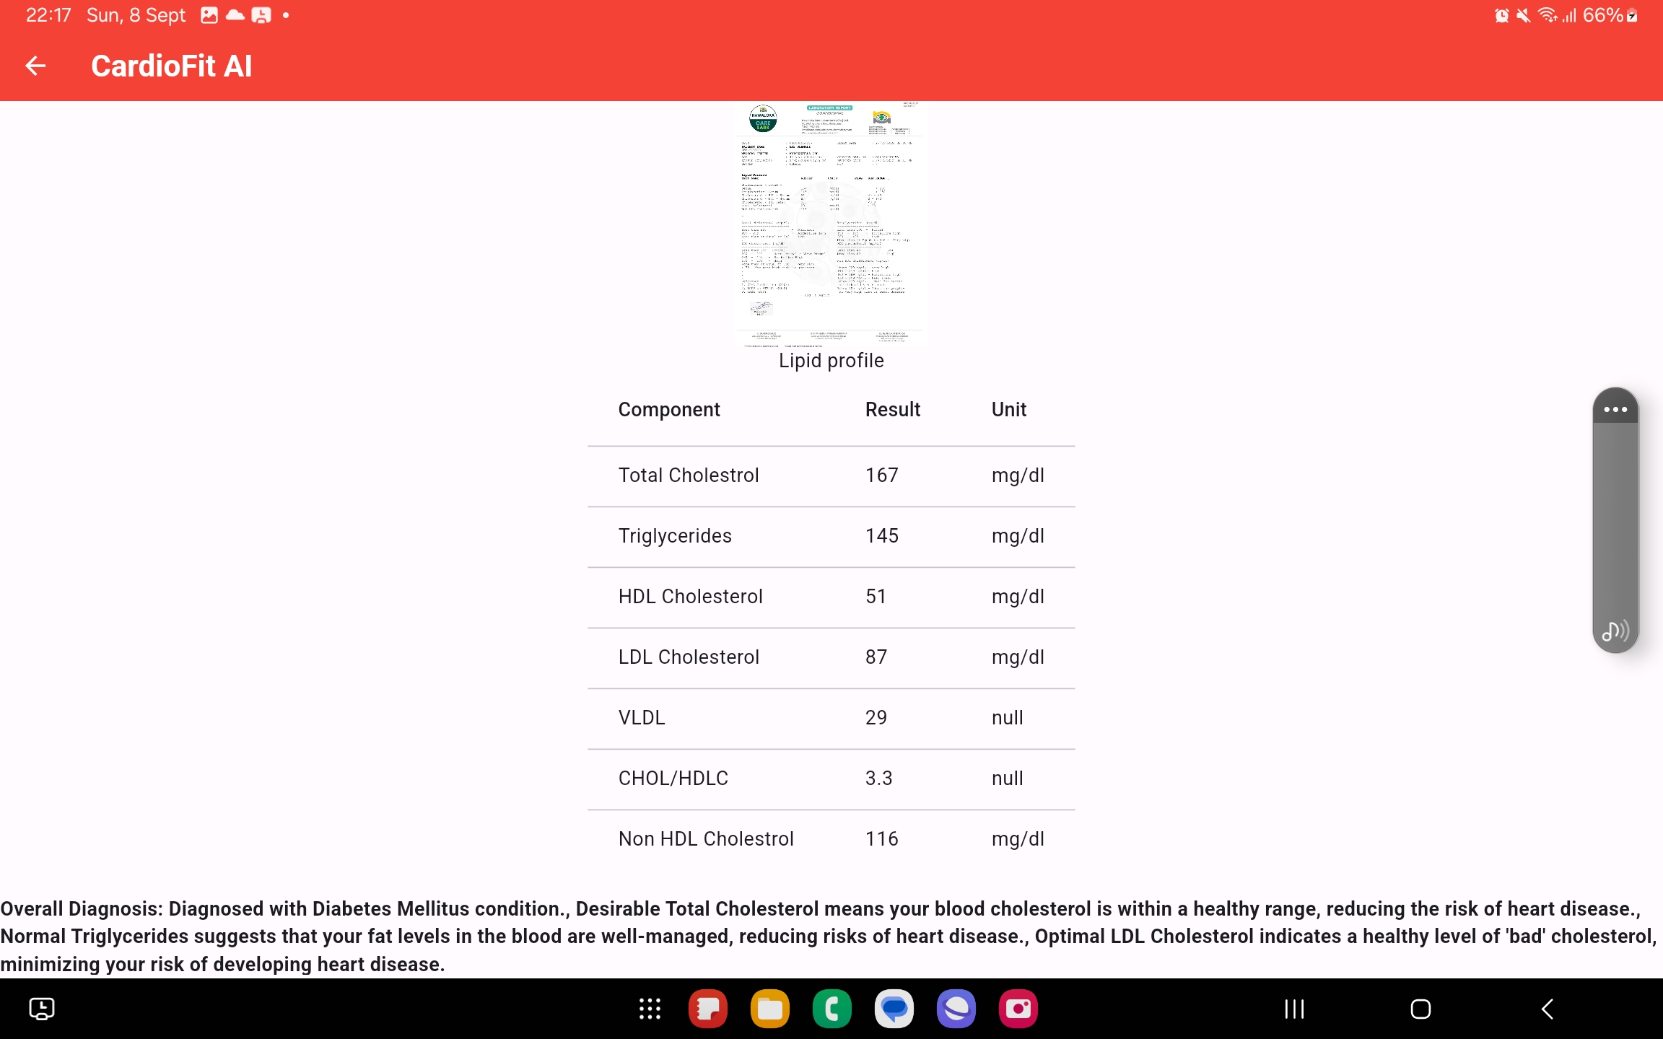
Proposed Vs Developed
Medicine Report Analysis Screen

Slide 53
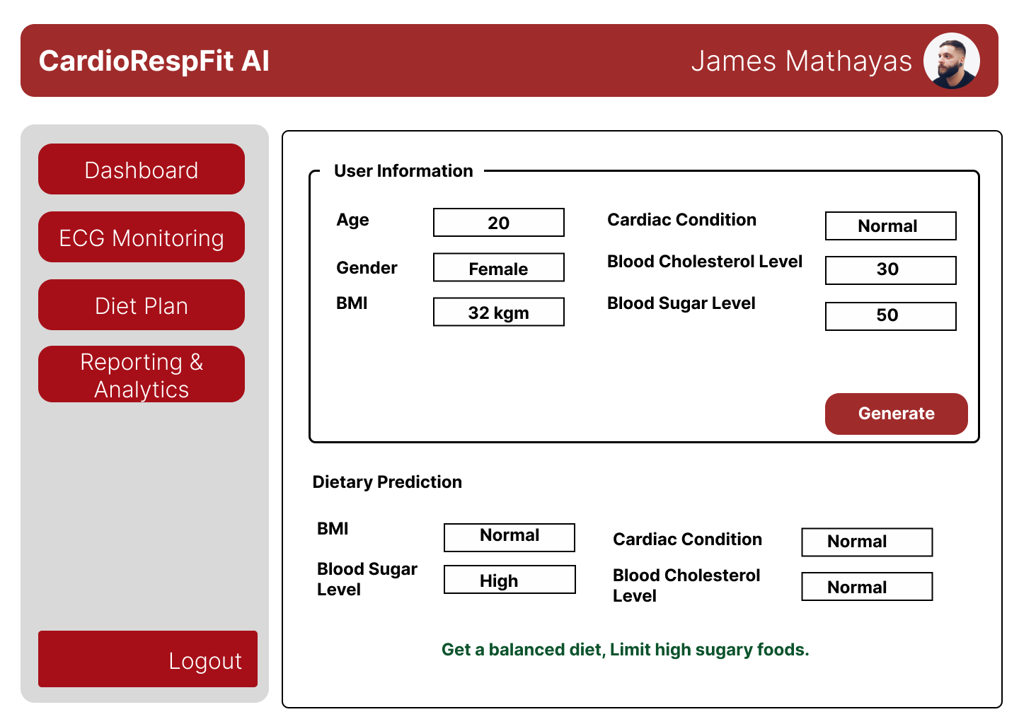
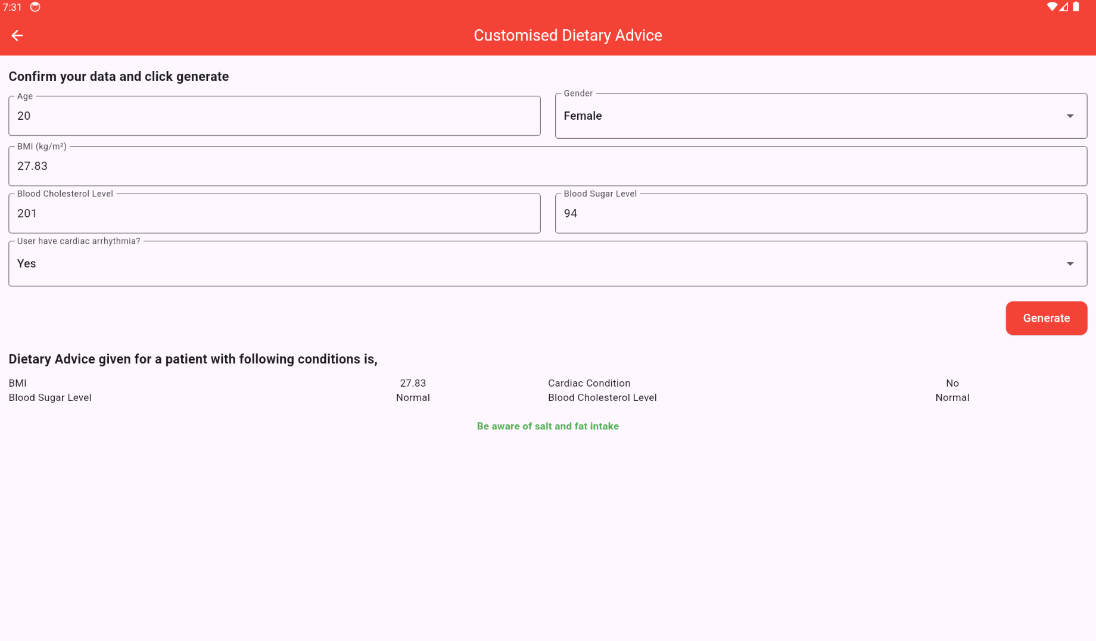
Proposed Vs Developed
Dietary Analysis

Slide 54
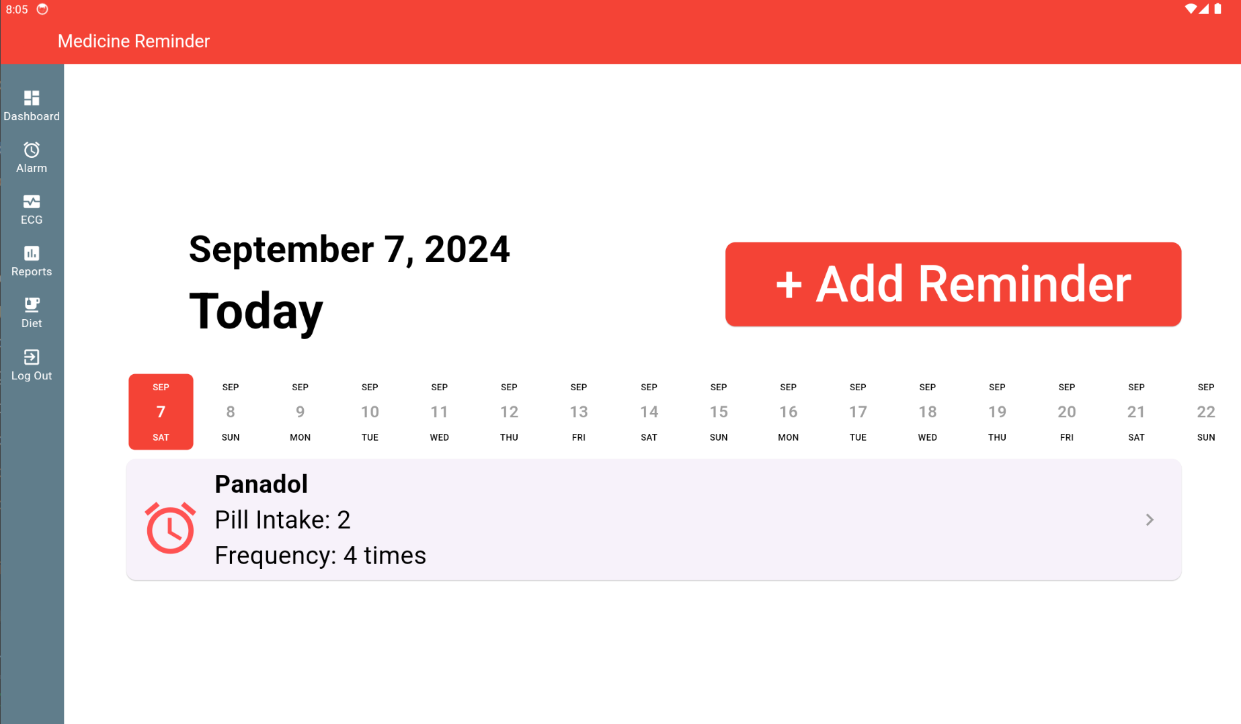

More Screen Shots
Alarm Service

Slide 55


More Screen Shots
Alarm Service

Slide 56
Progress of Project
Identify the analysis made by doctors observing patient health reports.
Collect necessary information to propose dietary advice in a customized manner.
Implement a proper methodology to scan and extract relevant components from users' medical reports and display its analysis
Based on the inputs obtained from user medical reports, BMI and Cardiac Health propose customize dietary advice
Develop a medicine Reminder Feature by extracting information from a prescription
IT21134180 | Vihansa S.A.S | R24-019

Slide 57
Best Practices, Functional and Non-Functional Requirements
Best Practices
Functional Requirements
System must accurately capture and record lead 1 ECG data from the palms.
System should reconstruct the remaining 11 ECG leads using deep learning techniques.
System should diagnose potential cardiac diseases.
The system should provide personalized dietary advice based on diagnosis and user data.
Interface to display diagnosis results and the propose dietary advice.
Ensuring code readability, maintainability, and reusability.
Non-Functional Requirements
The system should process lead reconstruction and diagnosis in near real-time.
Ensure consistent performance and diagnosis accuracy.
R24-019

Slide 58
Professional, legal, social,
security and ethical issues
Security Issues
Ethical Issues
The application should give accurate results
The application can be used by any users
User’s privacy should be maintained.
Only authorized users should have access to the diagnosis and personal data.
Input Sanitization to avoid scripting attacks
Social Issues
The system should be affordable and accessible to a wide range of users, especially those from low-income backgrounds.
Making the system accessible in areas with limited healthcare facilities, providing early detection of cardiac diseases.
R24-019

Slide 59
Commercialization Plan
Target healthcare facilities globally, offering this solution to clinics and telemedicine services.
Collaborate with cardiologists, dieticians, medical device companies, and healthcare providers.
R24-019

Slide 60

Eat Smart, Protect Your Heart
10,000,000
Cardiovascular Related Deaths
A Review of Healthy Dietary Choices for Cardiovascular Disease: From Individual Nutrients and Foods to Dietary Patterns
IT21134180 | Vihansa S.A.S | R24-019

